Slide 1



New 2022 Features in Adobe Cloud Manager for DevOps
Justin Edelson
Group Product Manager

Slide 2


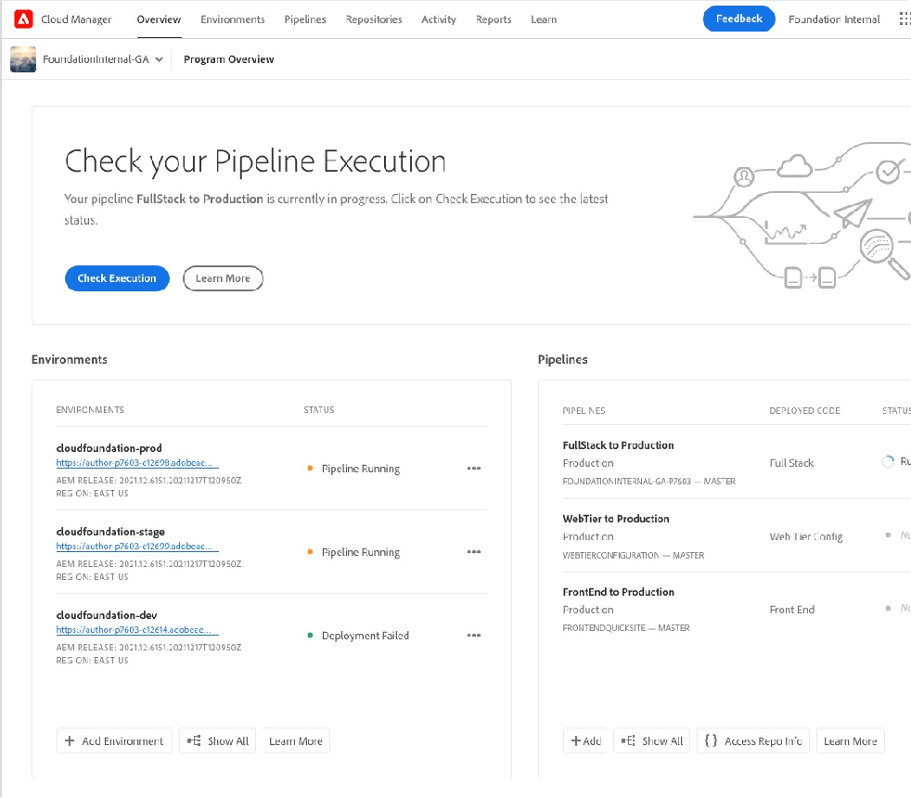
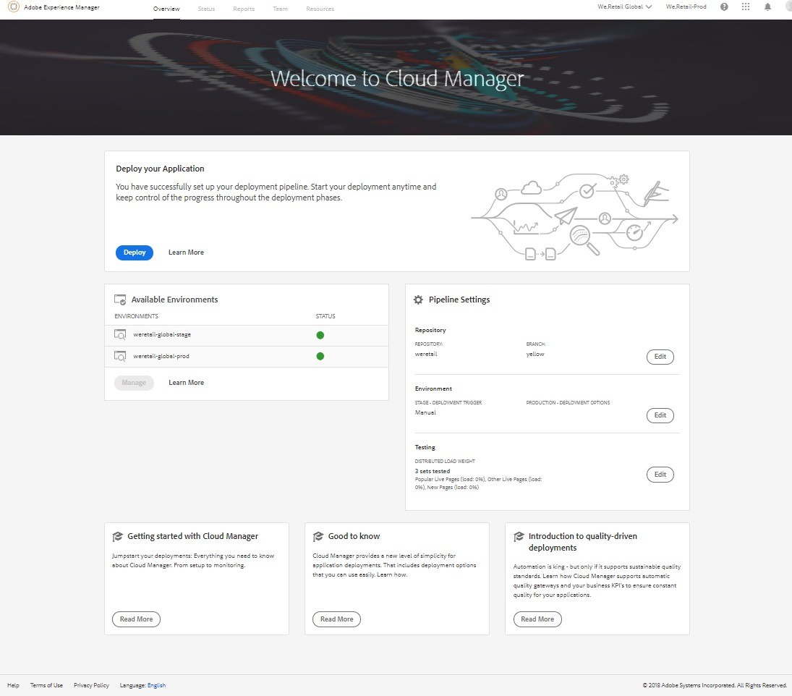

Cloud Manager for Adobe Experience Manager
Purpose-built unified DevOps platform for Adobe Managed Services and Adobe Experience Manager Cloud Service
Provision
Configure
Deploy

Slide 3



Cloud Manager Usage Growth
700000
600000
500000
400000
300000
200000
100000
0
2018
2019
2020
2021
Executions

Slide 4







Areas of Innovation
Project Flexibility
Performance
Reliability

Slide 5
Project Flexibility

Slide 6



Pipeline Types
1
Project build
2
Quality analysis
3
Stage deployment
4
Stage testing
5
Production deployment
Common Elements
Production
UI
Logs
1
Project build
2
Quality analysis
3
Dev deployment
API
Dev Deploy
Events & Webhooks
Build Process
1
2
Quality analysis
Quality Rules
Project build
Code Quality

Slide 7






Pipeline Source Code Types
Full Stack
Front End
Web Tier
OSGi Bundles & Configuration Client Libraries (JS, CSS) Component Scripts (HTL, JSP) Structural Content
Apache/Dispatcher Configuration*
AEM Sites Themes (JS, CSS)
Apache / Dispatcher Configuration

Slide 8
Pipeline Source Code Types
Full Stack
Front End
Web Tier
1 per Environment
Build based on Apache Maven
May automatically skip Apache/Dispatcher deployment
100s per Environment
Build based on npm
1 per Environment
No build script necessary

Slide 9
Front End Pipeline Demo

Slide 10
Performance & Reliability

Slide 11


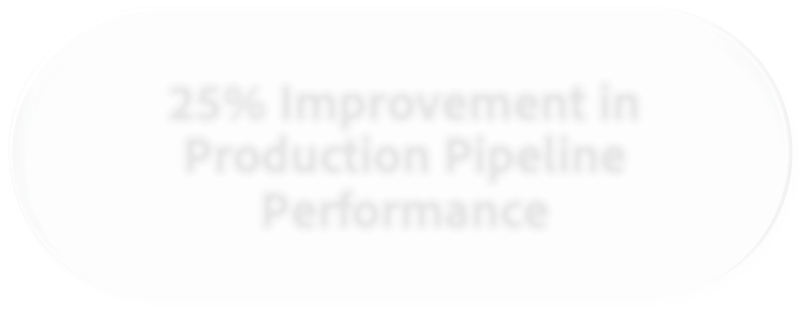





Performance & Reliability – 2021 Results
25% Improvement in Production Pipeline Performance
10% Reduction in Adobe- caused Failures
No Project Changes

Slide 12
Build Output Reuse
Run Build
Store Artifacts
Success?
No
Capture Current Git Commit
Have Existing Artifacts?
Execution Start
Continue with Execution
Yes
Copy Artifacts

Slide 13


Parallel Builds
Build Container #1
First Success Wins
Build Start
Build End
Build Container #2

Slide 14
Project Optimization

Slide 15




Project Optimization
▪ git submodules
▪ npm ci
▪ Package Structure
Flat Package Structure
Node Dependency Install
Shallow Submodules

Slide 16
Project Optimization – Package Structure
myco-all.zip
- /apps/myco-projects/install/myco-projectA-all.zip
- /apps/myco-projects/install/myco-projectA-partA-all.zip
- /apps/myco-projectA/install/myco-projectA-partA-ui-apps.zip
- /apps/myco-projectA/install/myco-projectA-partA.jar
- /apps/myco-projects/install/myco-projectA-partB-all.zip
- /apps/myco-projectA/install/myco-projectA-partB-ui-apps.zip
- /apps/myco-projectA/install/myco-projectA-partB.jar
- /apps/myco-projects/install/myco-projectB-all.zip
- /apps/myco-projectB/install/myco-projectB-ui-apps.zip
- /apps/myco-projectB/install/myco-project.jar
myco-all.zip
- /apps/myco-projects/install/myco-projectA-all.zip
- /apps/myco-projectA/install/myco-projectA-ui-apps.zip
- /apps/myco-projectA/install/myco-projectA.jar
- /apps/myco-projects/install/myco-projectB-all.zip
- /apps/myco-projectB/install/myco-projectB-ui-apps.zip
- /apps/myco-projectB/install/myco-project.jar
myco-all.zip
- /apps/myco/install/myco-ui-apps.zip
- /apps/myco/install/myco.jar
myco-all.zip
/apps/myco-projectA/install/myco-projectA-partA-ui-apps.zip
/apps/myco-projectA/install/myco-projectA-partA.jar
/apps/myco-projectA/install/myco-projectA-partB-ui-apps.zip
/apps/myco-projectA/install/myco-projectA-partB.jar
/apps/myco-projectB/install/myco-projectB-ui-apps.zip
/apps/myco-projectB/install/myco-project.jar
Flatter Packages – 10-30 minutes faster
One Exception – Always wrap 3rd party packages

Slide 17


Project Optimization – Node Dependency Management
Use npm ci, not npm install
More performant – 50% faster than npm install
More reliable – ensures same versions are used locally and in cloud
Done automatically on Front End pipelines

Slide 18
Project Optimization – git submodules
pom.xml
.gitmodules
projectA
pom.xml
src
projectB
pom.xml
src
projectC
pom.xml
src
Shallow Submodules – 5-10 minutes faster

Slide 19







Conclusion
Flexible Pipeline Code Types
Continual Performance & Reliability Improvements
Further Project Optimization In Your Hands

